Slide 1
Coding World
By Aratrika Pal

Slide 2
Introduction
In this world of high class job opportunity you have to know many languages as to secure high paying job offers. And for that coding websites are necessary. So in this context we have decided to build a free coding site which will help us in learning many languages preferable for jobs.

Slide 3
Approach
We use HTML, CSS and JavaScript to build this website.
We just create a basic welcome page using HTML, CSS
Then we create two pages Sign-up and Login pages where we use JavaScript to store the id and password.
After Log-in you will be directed to the main page where we just got the special courses
And then there is a link for the all course pages.
In the course page we have use the youtube API link in JavaScript to link the whole playlist of course

Slide 4
Learnings
We just learn how to make the basic structure of the website using the HTML
Also we learn how to make the styling in that page using the CSS
And for internal workings like password and name, id storing
Use of API key to link the playlist videos from any site

Slide 5
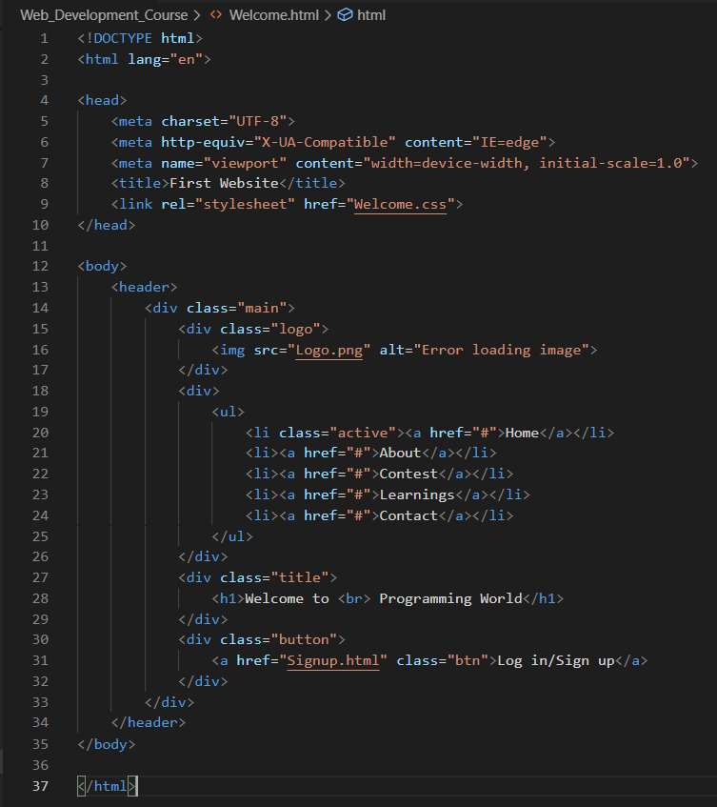
Welcome Page Creation
HTML Code:
In this part we just created the basic welcome page for the website
Here we just use <div> </div>, <ul> </ul>, <li> </li>, <h1> </h1> and the anchor tag(use to link to another website or url)
We added one image as a logo for the coding site
We’ve created class to just separate the specifications of the code and easily decorate them in CSS part easily.
For HTML we just write the code in body part and link the CSS part to design the hard code in head part

Slide 6
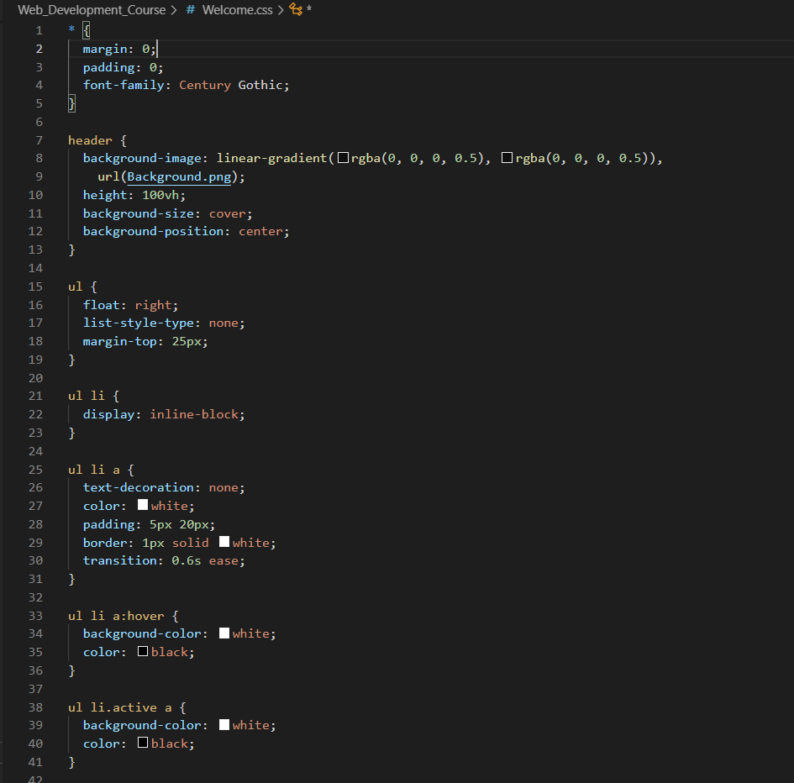
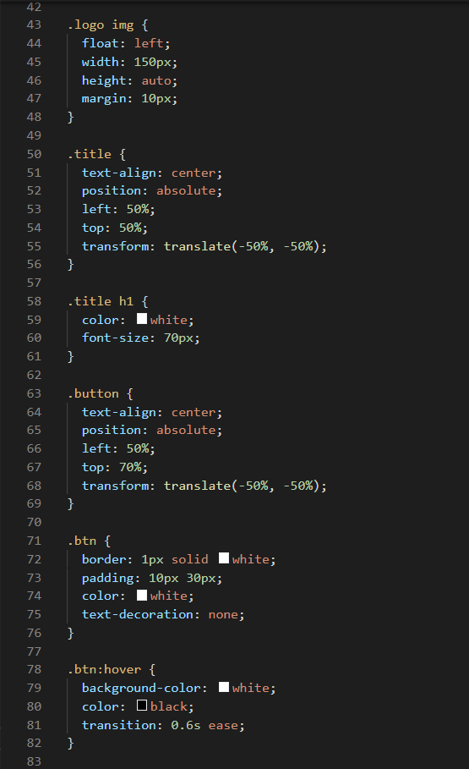
Welcome Page Creation
CSS Code:
Here we just call the classes that we’ve created in HTML page and decorate them
We’ve added one background image and fit it in the welcome page properly
The <ul> </ul> part where we created some list of words. Mainly they’re created to use as buttons and also we’ve use there anchoring tag to link to corresponding websites
The buttons are given white border and also hovered so that when we just put the cursor there the color of the buttons will change
We’ve added one more button for login/signup
For classes “.” to call classes in CSS and “#” to call ids in CSS

Slide 7

Welcome Page

Slide 8
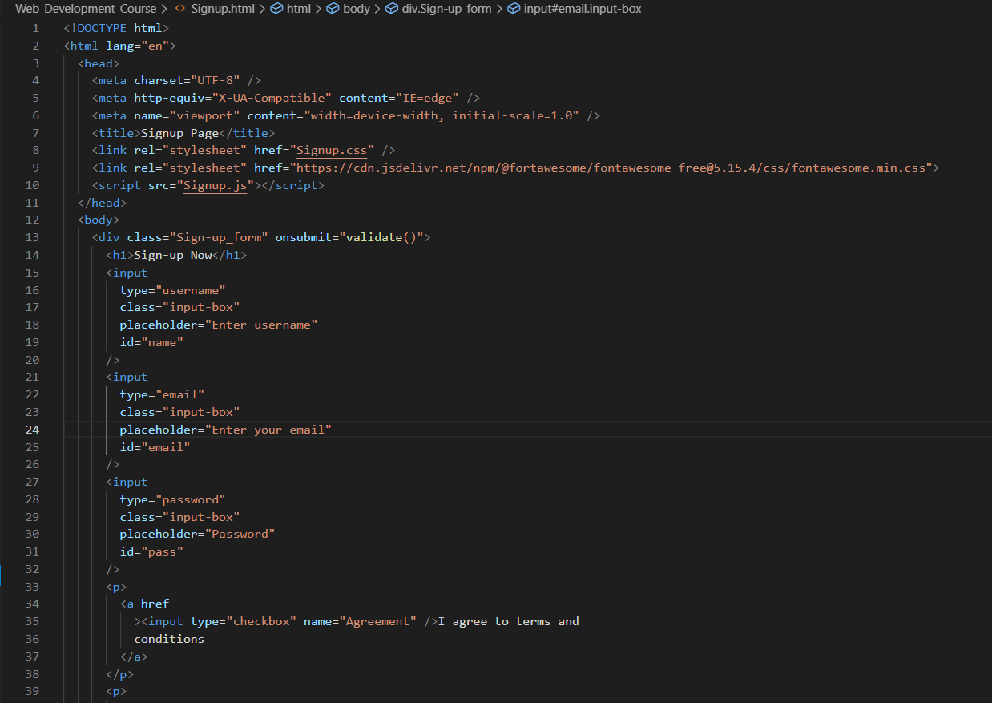
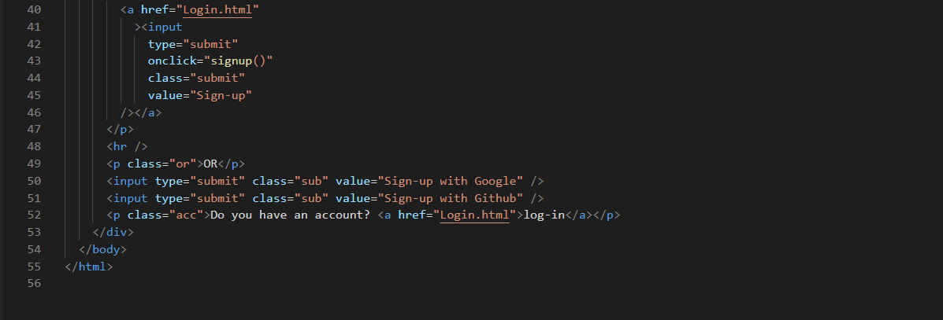
Sign-up Page Creation
HTML Code:
In HTML code we just created a form type box.
There we take three types of input-
Username
Email
Password
And also I’ve implemented a checkbox for the terms and conditions which is hyperlinked
If anyone already have the account and want to log-in directly there also provided an option for log-in which is hyperlinked to login page.

Slide 9
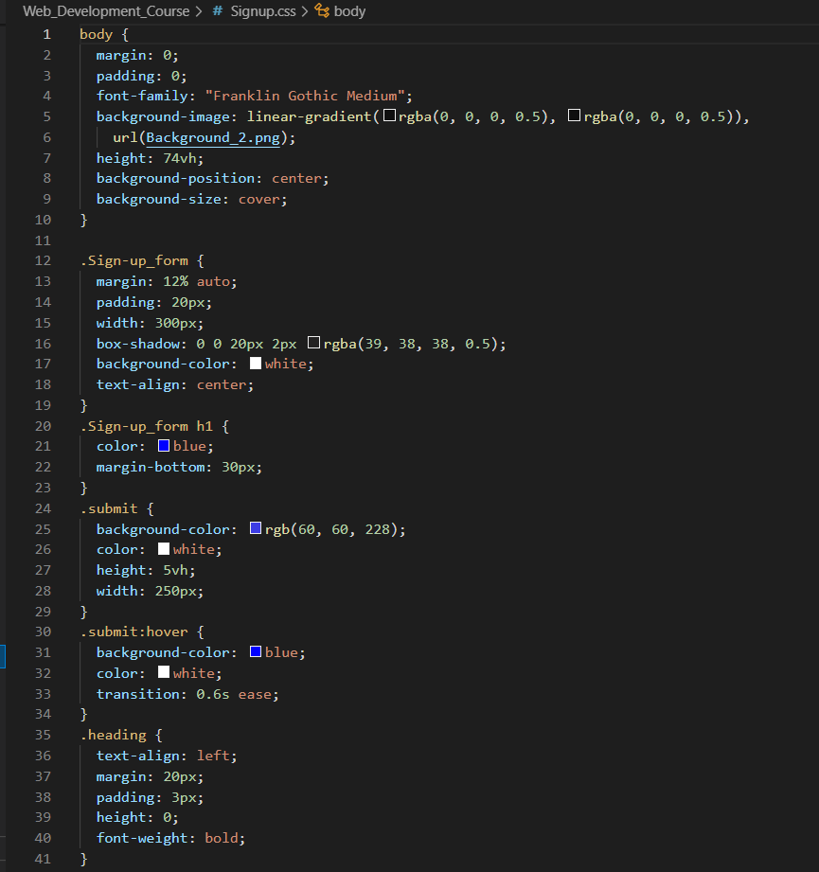
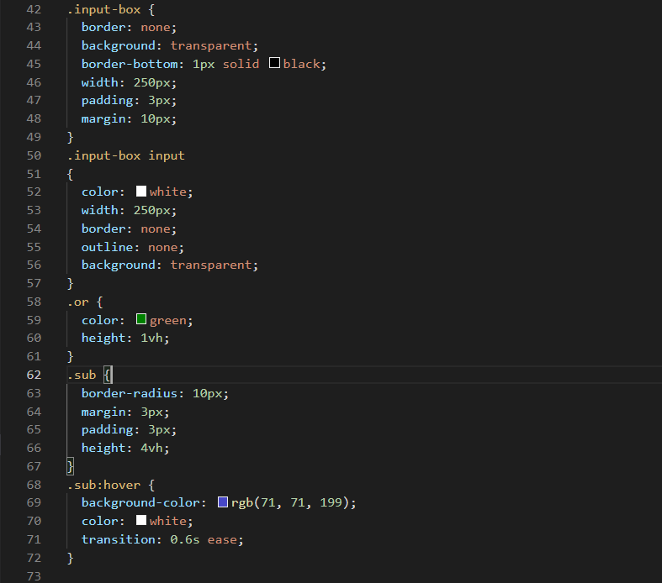
Sign-up Page Creation
CSS Code:
We’ve just use the background image same as the Welcome page as we want to create the Sign-up box just in the middle and for to show it just as to pop up when we click the button
We put the background colour for the box as white
The submit button which is also linked with the Log-in page and is hovered and background is colour is kept as blue
There are two buttons also present for sign-up using Google and Github
The input box background for taking input username, password etc. are kept as transparent
The Google and Github buttons have some border.

Slide 10
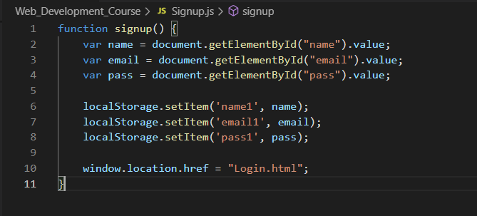
Sign-up Page Creation
JS code:
In the Java Script part we just take three variables to pass the user’s input for username, password and email
And store them in the local storage
After successfully sign-up user will be directed to the Log-in page directly

Slide 11
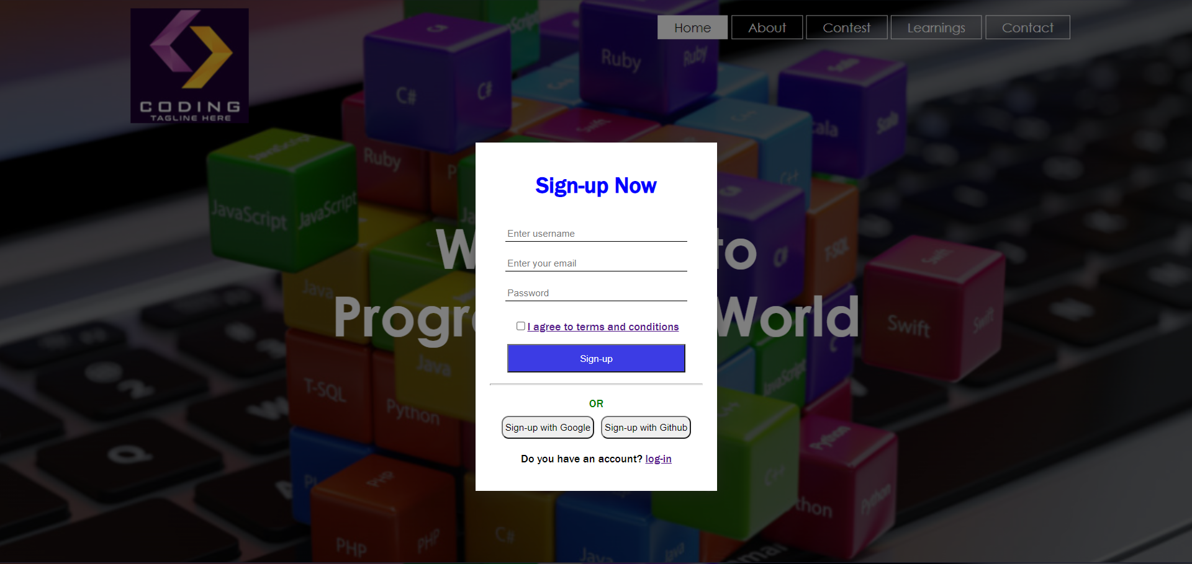
Sign-up Page

Slide 12
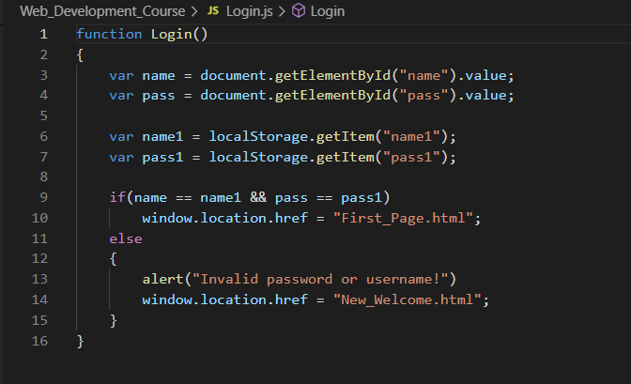
Log-in Page Creation
JS Code:
In Log-in page we just take the user input for username and password and collect the data that was stored in local storage during Sign-up time.
After that we compared both of the data. If both are same then they are linked or can directed to the course page but if they aren’t same then they are returned to the same Welcome page
In this Welcome page no sign-up button will be present only log-in button will be there so it is named as New_Welcome page.
NOTE: As both of the Sign-up pages are made same. Their HTML and CSS codes are also same. Also in Log-in page there are less number of buttons and input taker bars.

Slide 13
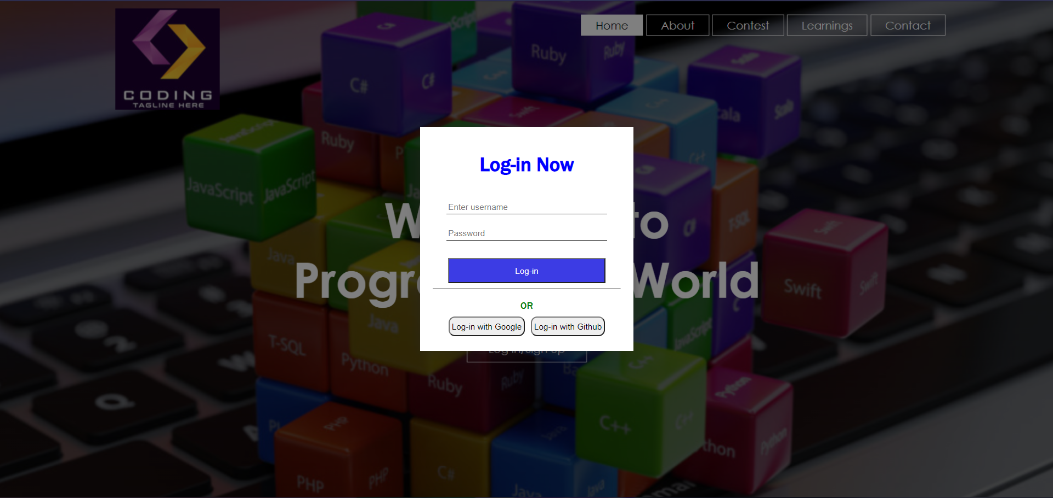
Log-in Page

Slide 14
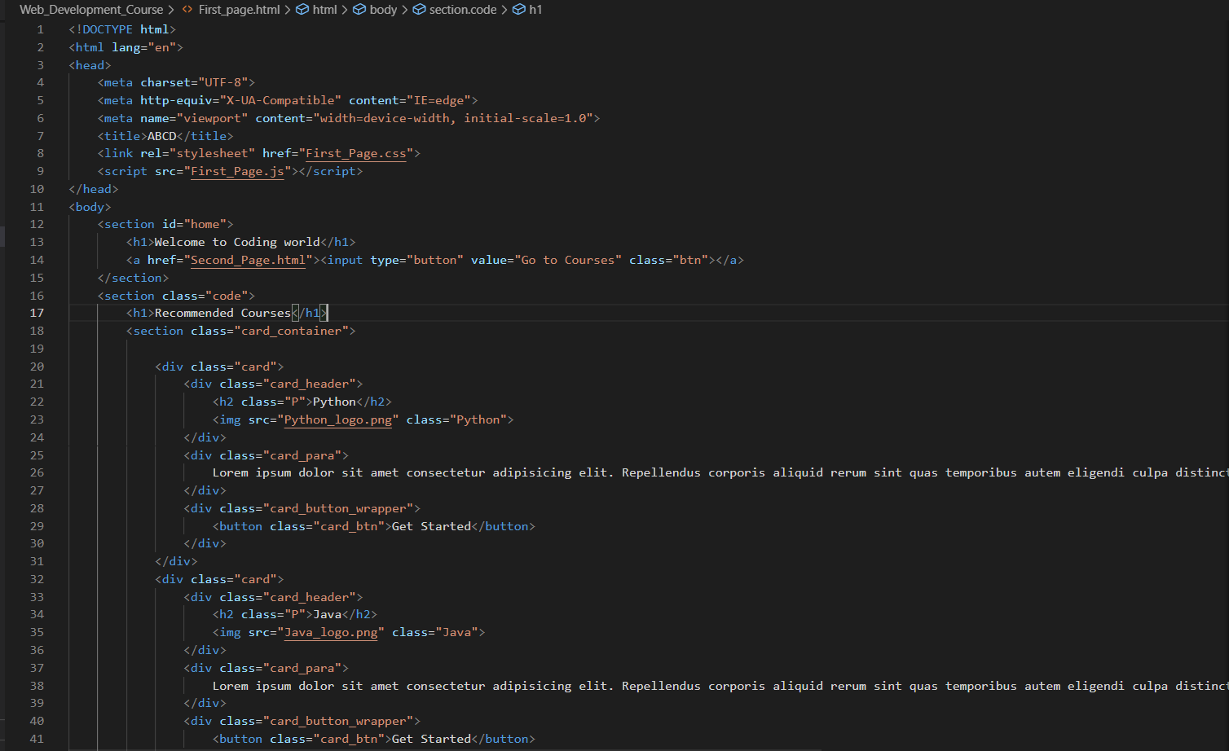
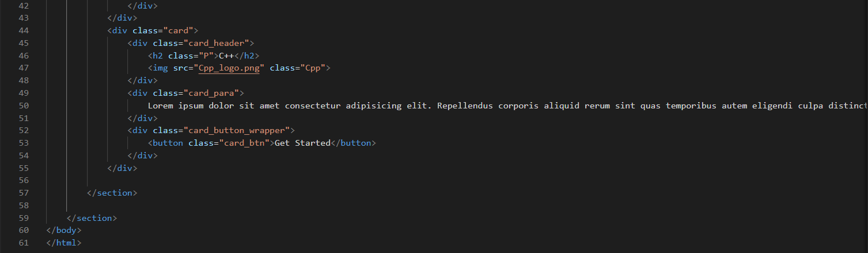
Main Page Creation
HTML Code:
Here in the first upper half we gave the course page link using a button and some heading for the main page
And after that we just created some cards
Where the best recommended courses are attached and some description of the courses are also given
In that card we embedded a logo of each of the coding languages and all of them are learning type
Also in the card we created a button which is linked to the page of the specific course
For description we use “Lorem” keyword which provide us by default 50 random words

Slide 15
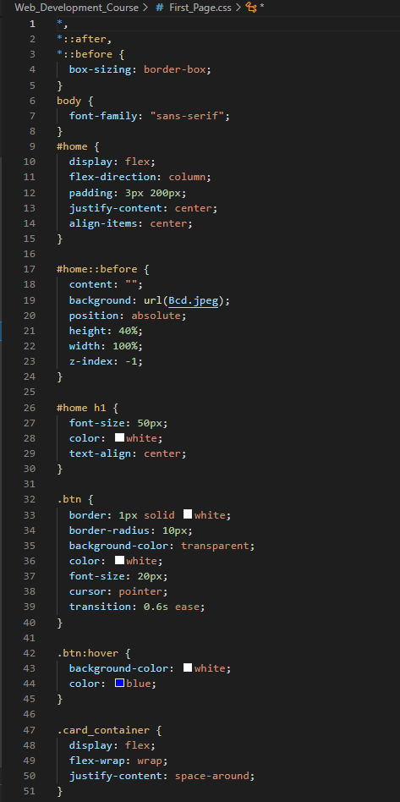
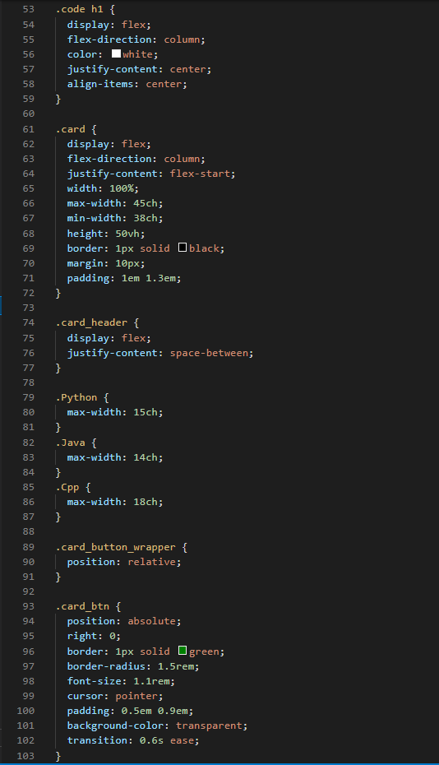
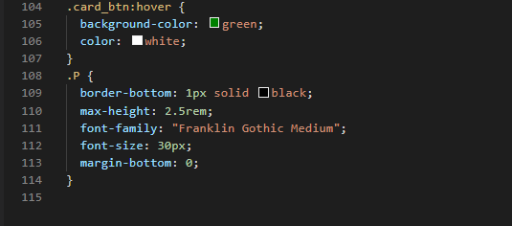
Main Page Creation
CSS Code:
In CSS part we add a quarter type background image where the buttons and the heading are placed for decoration
We just shortened the height of the image
Next the description and the cards are bordered and the logos are placed in proper way
We use to arrange the cards as “flex” and put the “flex-direction” as “column” so the cards are placed side by side
We put a “min-width” so that in a screen a limited(only 3) cards can be placed
The “Get Started” buttons are placed in the right bottom after the end of the description of the corresponding cards
“*” is basically use to select all the elements of the page to keep them as “border-box”

Slide 16
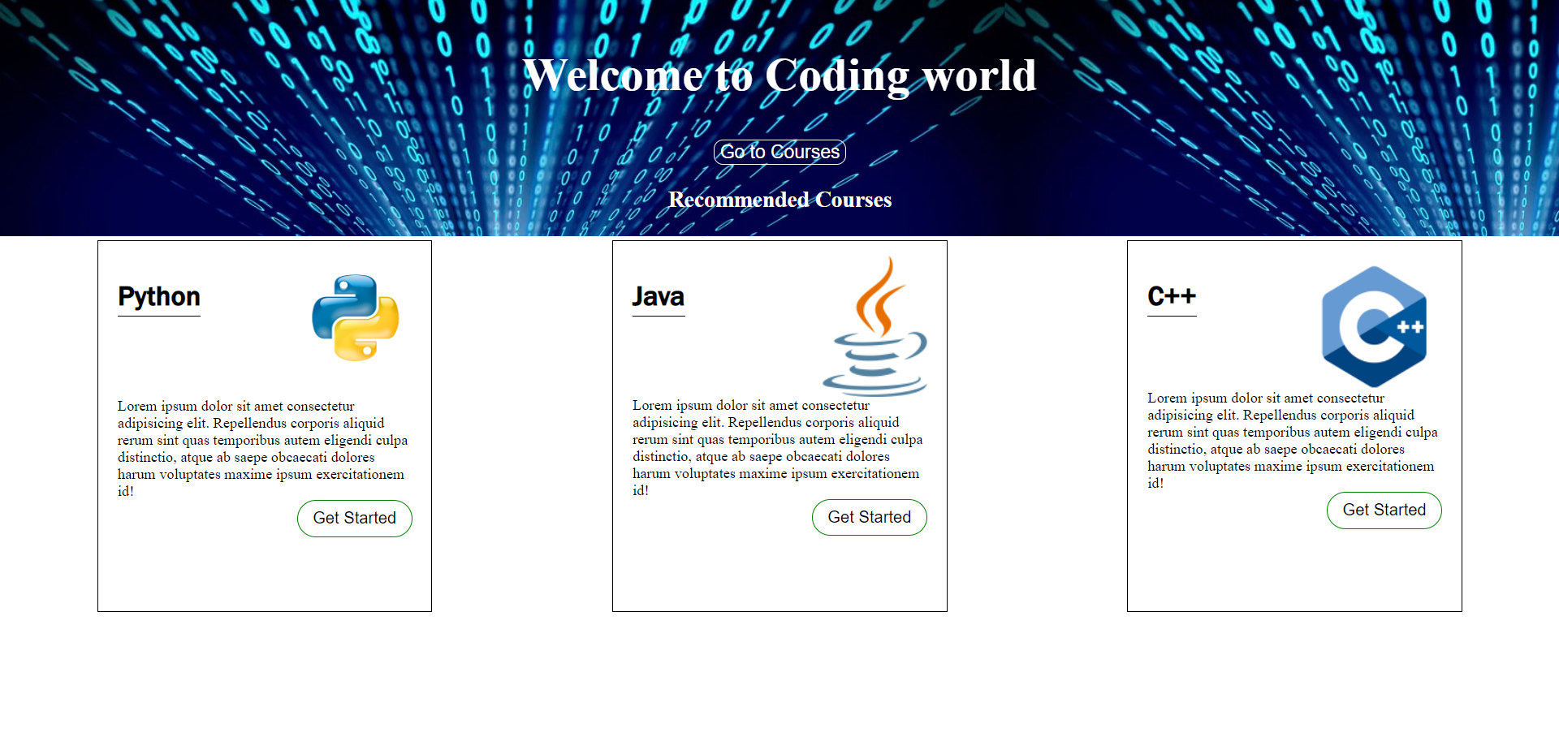
Main page

Slide 17
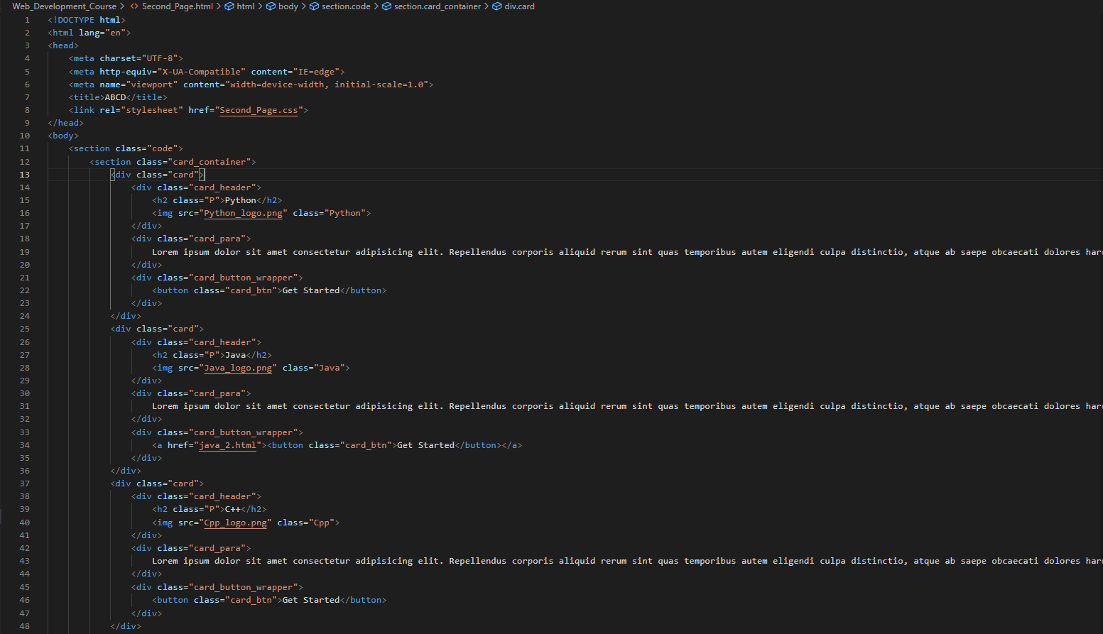
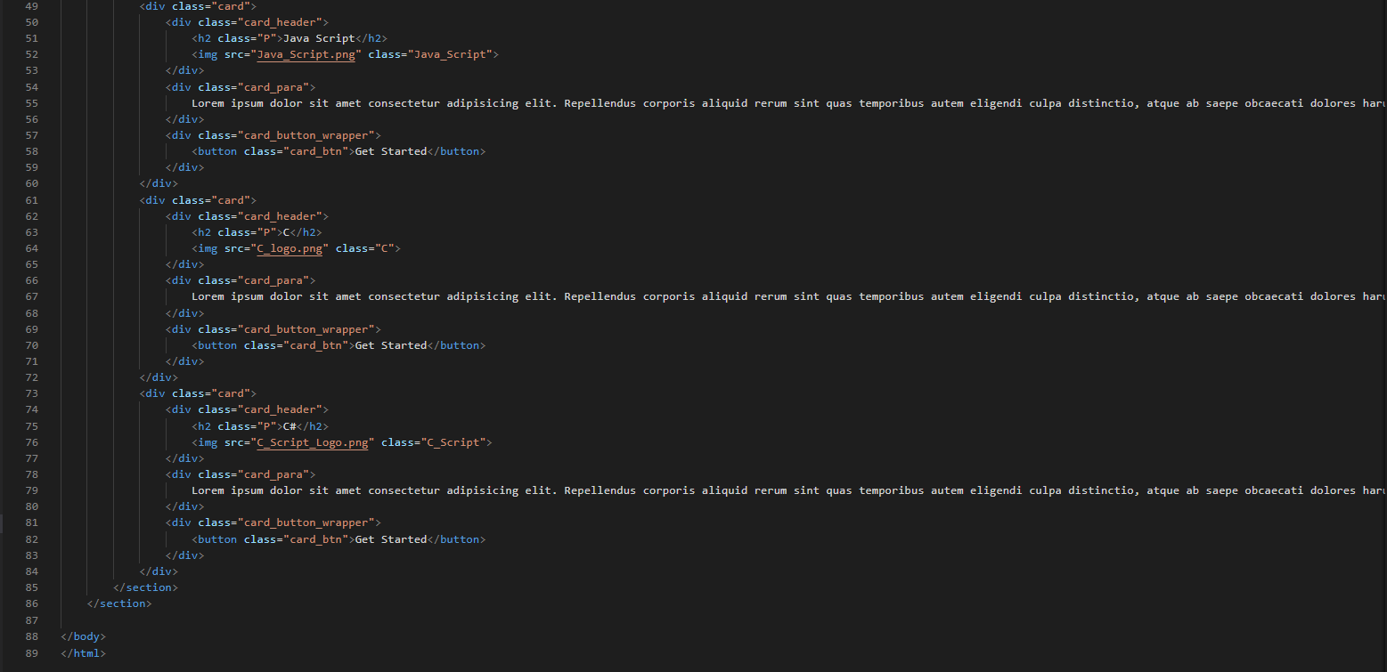
Course Page Creation
HTML Code:
As of the Main Page here also the cards are created
Here no of cards are more than from the Main Page
Also for each card one corresponding logo and link of specific course page are provided using a button
Some description of the language are also been provided here

Slide 18
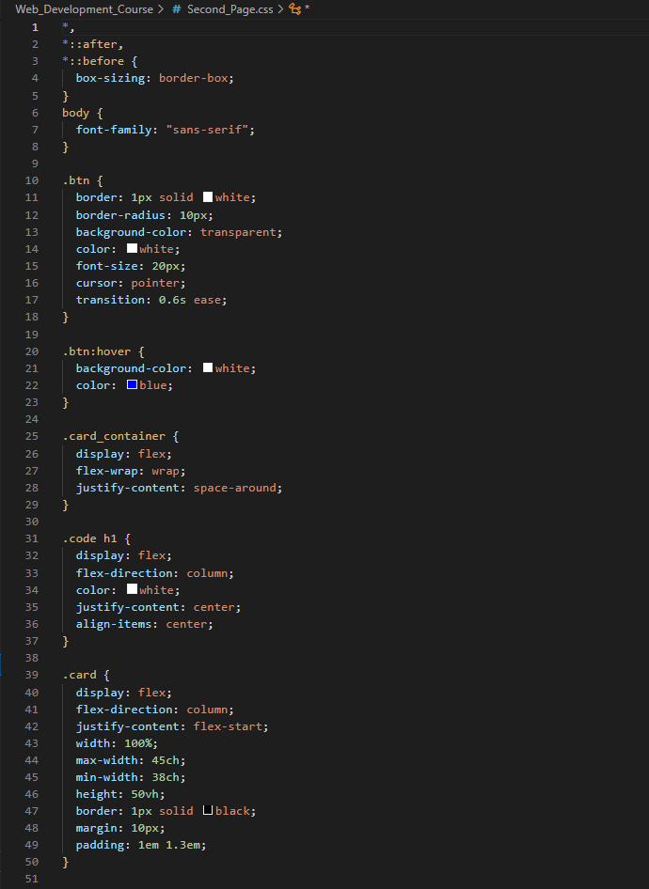
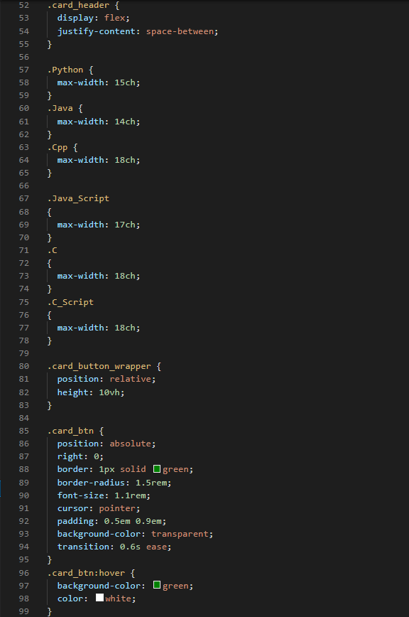
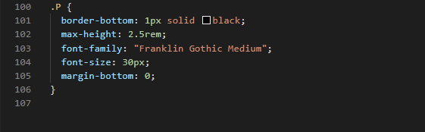
Course Page Creation
CSS Code:
Everything is same as of the Main Page
Here “min-width” is made fixed so that no more than three cards can be there in one page
All the card buttons are hovered so that when we just move the cursor there it will change its color and also provided transition of the hovering so that the change of the color is done smoothly

Slide 19
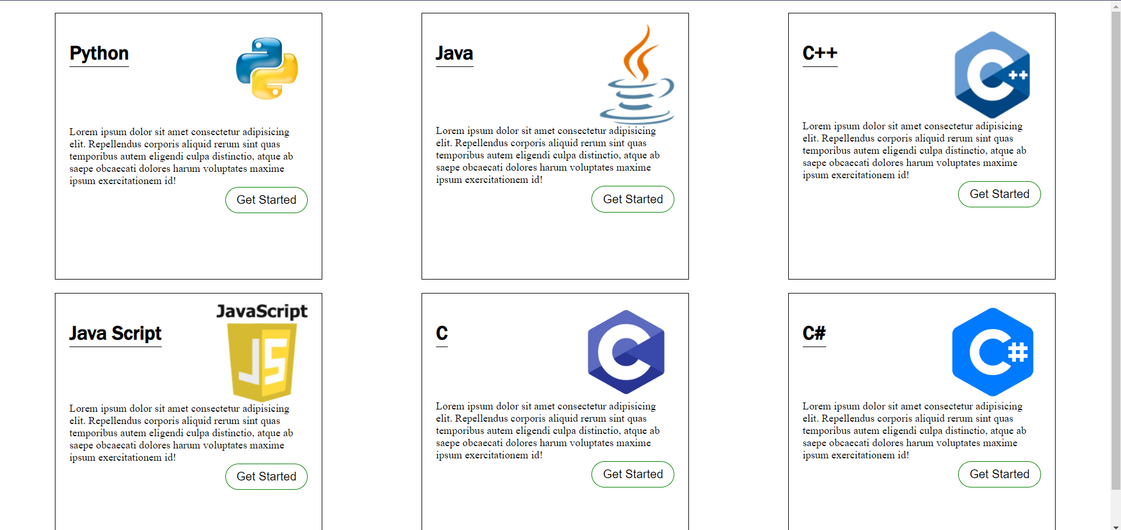
Course Page

Slide 20
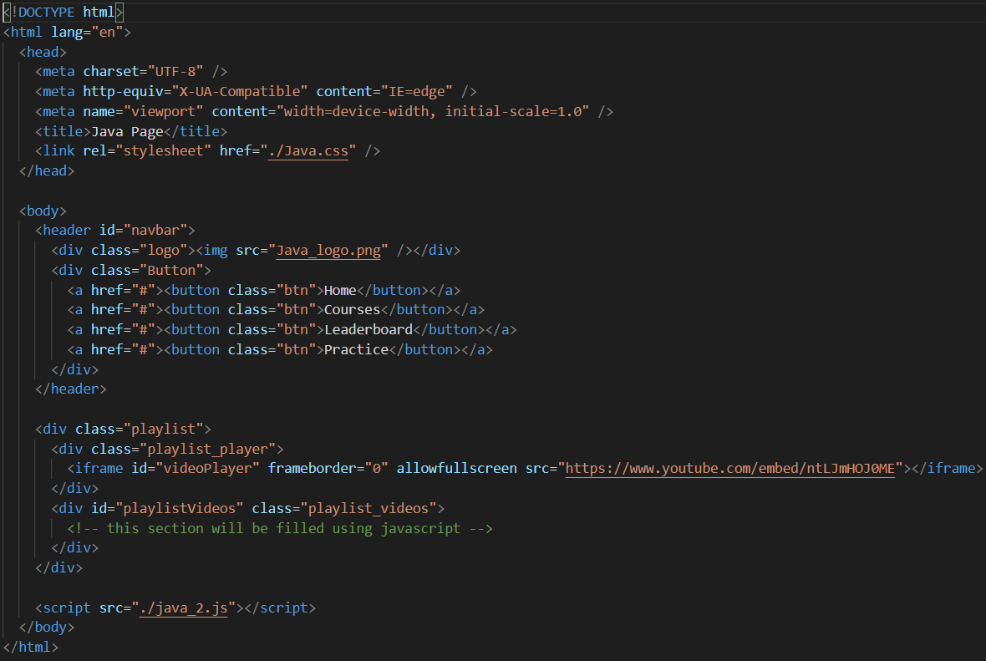
Java Course Page Creation
HTML Code:
For the upper quarter we create a navigation bar where we put the java logo and some buttons for going to main course page or to practice page or to see what your skill level is
And in the main screen the java videos are added.
There is one video taken as thumbnail video and others are put in the right side for selection

Slide 21
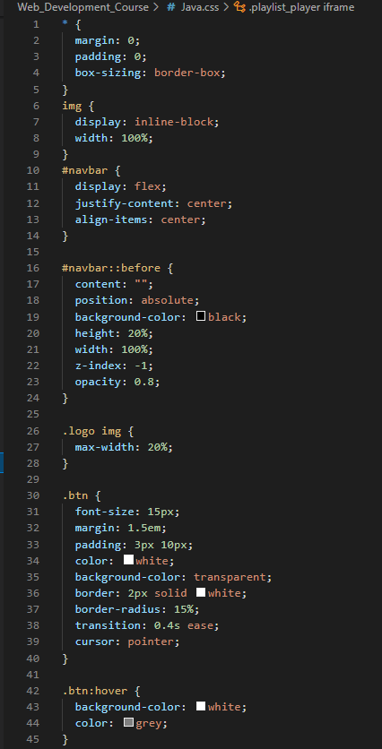
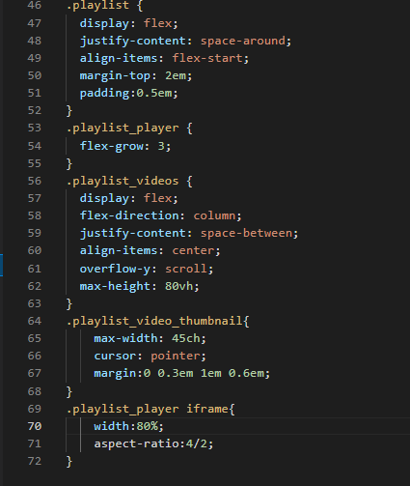
JAVA Course Page Creation
CSS Code:
In the navbar we have input grey color and the buttons are bordered in white and the logo is also embedded there
For the playlist part, the first video taken as thumbnail video and its image was embedded in the left and the other images of the videos are in right side with a scrolling feature which is added by using “overflow-y” as “scroll”
The main video was put as an aspect ratio of 4/2
And also the cursor when moved to the video will be pointer as cursor option is changed to pointer here

Slide 22
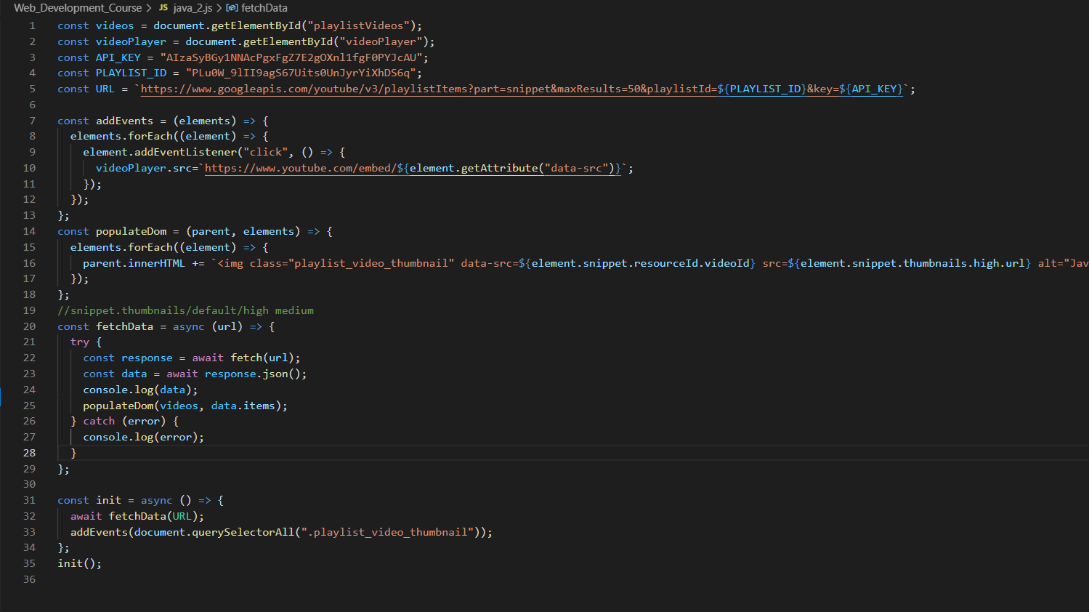
JAVA Course Page Creation
JS Code:
Here we have taken the API of youtube channel and store it in the API Key part
Also here the whole playlist id was taken
Both of them are used to generate the URL of the videos
Next we just create a function named “addEvents” where we add the feature when we click to the other videos in the scroll part it will come to the main thumbnail part
“forEach” function will take the image of the videos in the thumbnail part
“fetchData” function will fetch the data of the videos from the URL that was generated basically from youtube

Slide 23
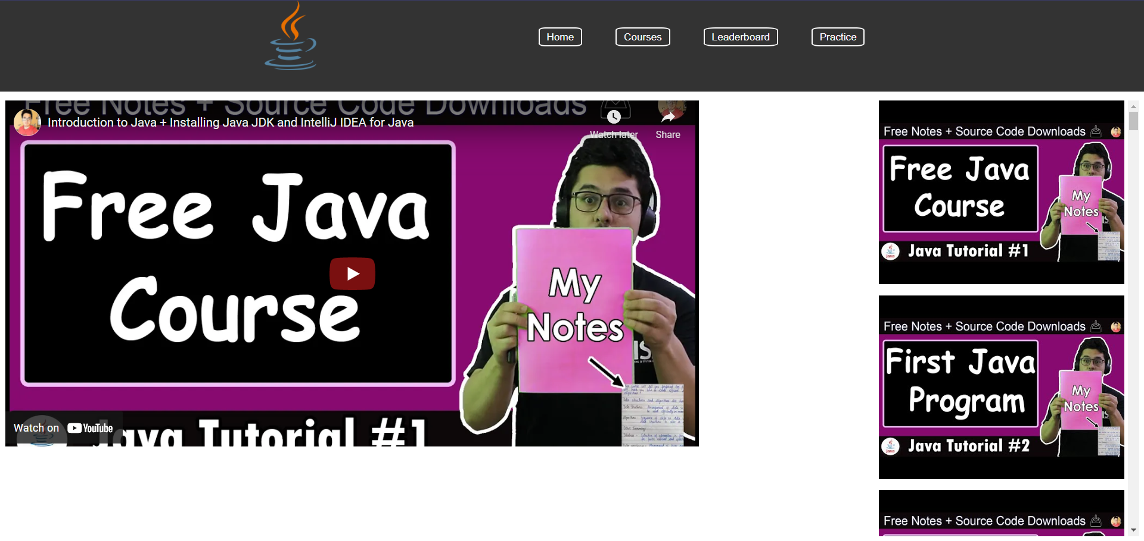
JAVA Course Page

Slide 24
Conclusion
From this project we have earned many things, how to accomplish the work in a group, how to use APIs to take the data from any sites, also how to store password, username in the local storage and how to fetch that data and many more things
This is a basic project for our learnings of HTML, CSS and JavaScript and hope we can improve the mistakes what we’ve done in this project in future
Finally all in one is we just learn a new thing totally new topic and also make some application of this in our study life

Slide 25
Acknowledgement
All what I’ve done and learn is not goes for my credit. It’s a group work and project. So, there are some of my friends and also our project guider/mentor whom I want to acknowledge. First of all my acknowledgement goes to our honorable professor Dr. Sekhar Kumar Mondal. As he just provide us such a good project for our learnings and also for future usability. Next my acknowledgement for my teammate Aratrika Pal. She just help me every time in doing this project also help me providing me some study material and finally to some of my friends, they also help me to understanding this project.
__AratrikaPal__
Student’s Signature
____________________
Teacher’s Signature

Slide 26
Thank you
The End

